Slide 1

MOVIE RECOMMENDER SYSTEM
Author: Team 14
Yashshree Baviskar, Ravi Teja, Nilkantha Bag & G Srineha, Chaitanya Dubal

Slide 2
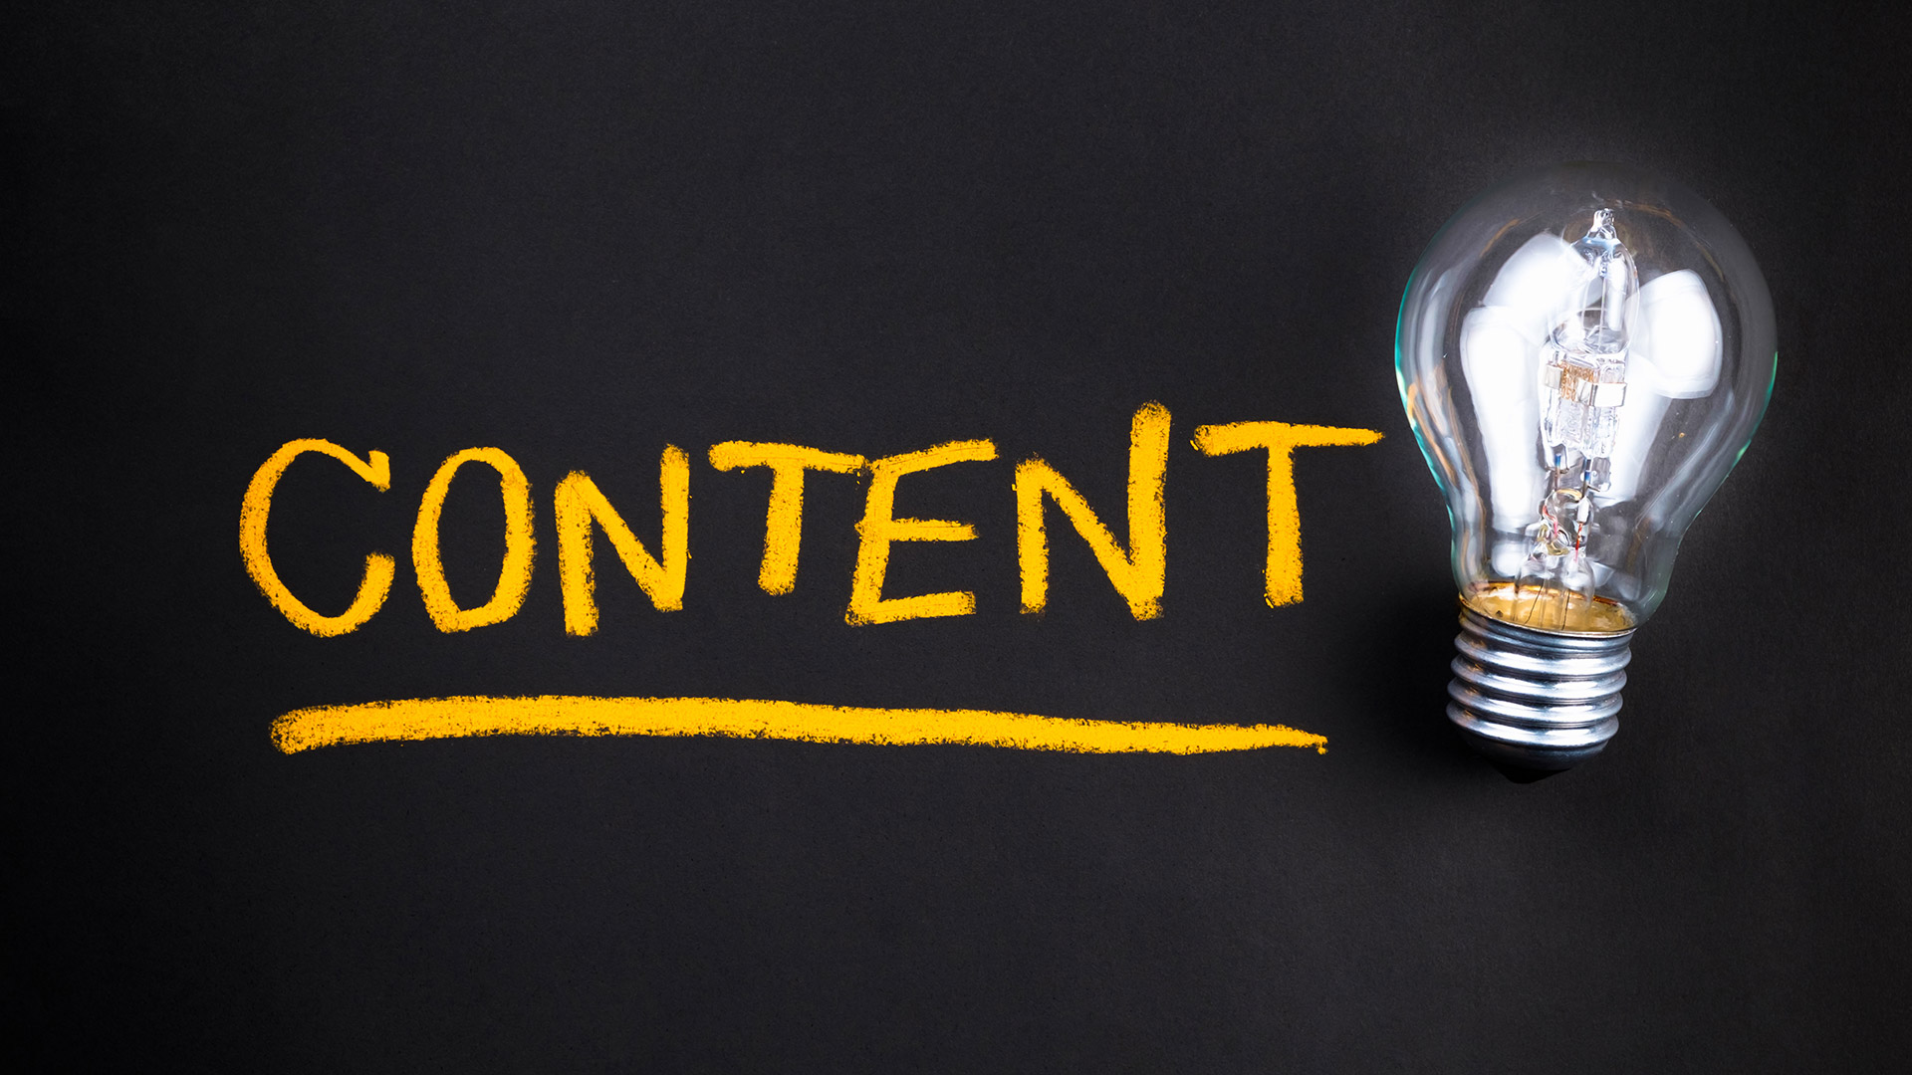
Content
Introduction of Recommender System
Types of Recommender System
About the Content /Popularity /collaborative Based Recommendation
Problem Statement
About Dataset
Objective
Methodology
Data Preprocessing : Text Mining
Explanatory Data Analysis
Model Building using Cosine Similarity
References

Slide 3

INTRODUCTION
RECOMMENDER SYSTEM

Slide 4
Recommendation Systems are used to predict the "rating" or "preference" that a user would give to an item. Almost every major tech company has applied them in some form. Personalized recommendation made available by it.

Slide 5
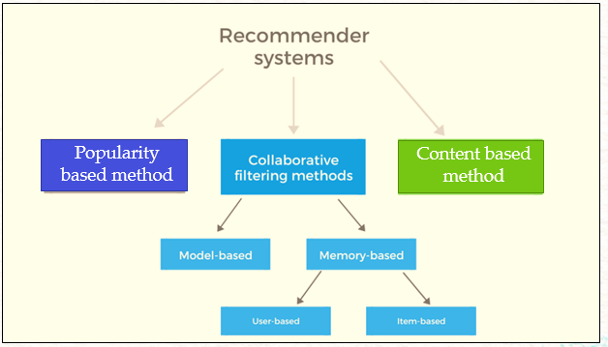
TYPES OF RECOMMENDATION SYSTEM

Slide 6
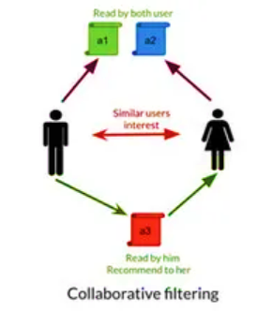
ABOUT COLLABORATIVE BASED RECOMENDATION
Collaborative filtering systems apply the so-called similarity index-based technique. In the neighborhood-based approach, a number of users are selected based on their similarity to the active user.
Collaborative-filtering systems focus on the relationship between users and items. The similarity of items is determined by the similarity of the ratings of those items by the users who have rated both items.

Slide 7
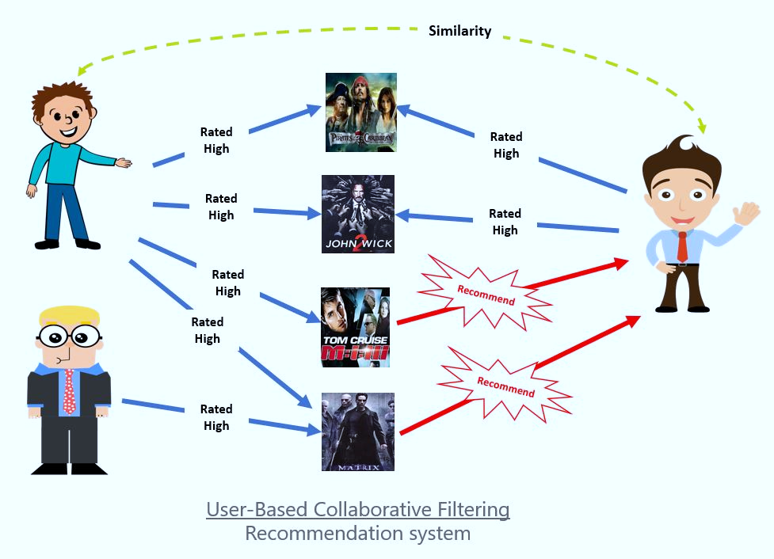
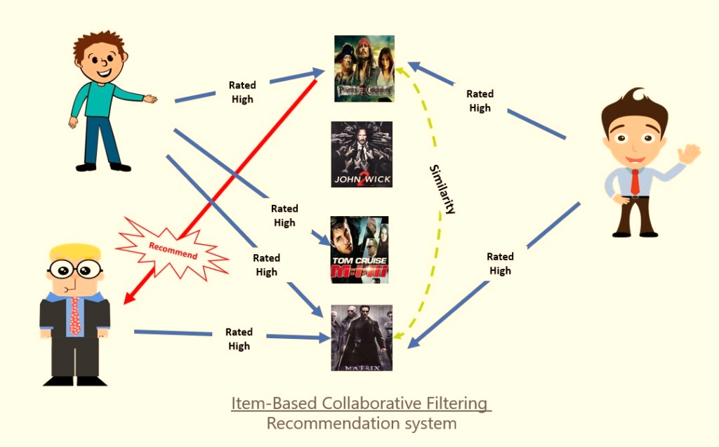
TYPES OF COLLABRATIVE RECOMMENDATION SYSTEM

Slide 8
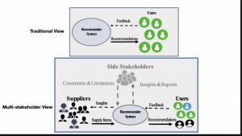
ABOUT POPULARITY BASED RECOMMENDED SYSTEM
It is a type of recommendation system which works on the principle of popularity and or anything which is in trend.
These systems check about the product or movie which are in trend or are most popular among the users and directly recommend those.
It does not suffer from cold start problems which means on day 1 of the business also it can recommend products on various different filters.
There is no need for the user's historical data.

Slide 9
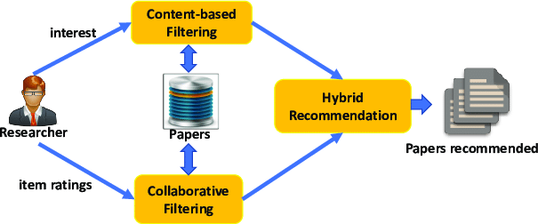
ABOUT HYBRID RECOMMENDER SYSTEM
A hybrid recommendation system is a unique subtype of recommendation system that combines collaborative and content filtering techniques
The proposed hybrid filtering approach works in the three phases: Initially, it retrieves the top-n users similar to the active user using their profiles. These similar users are also known as neighbors who have used the content in the same way as the active user has consumed.

Slide 10
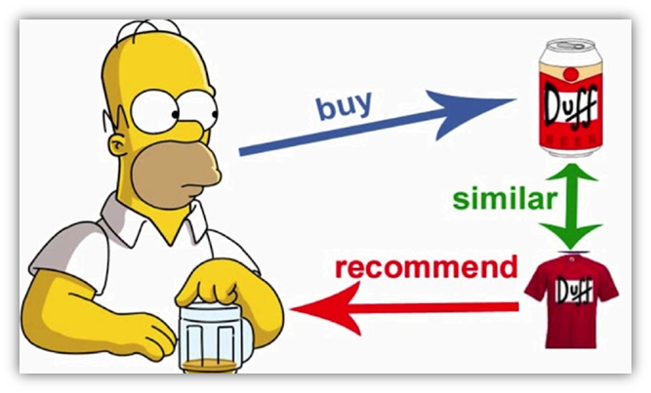
ABOUT CONTENT BASED RECOMENDATION
It suggest the simillar item based on particular item
It suggest the product based on user interest
In this system, keywords are used to describe the items, and a user profile is built to indicate the type of item this user likes
Content-based recommender systems can also include opinion-based recommender systems

Slide 11

PROBLEM STATEMENT
Using different techniques of Machine Learning, we need to build a Recommender System that recommends movies based on “ Cast, Genre, Reviews, TMDB/IMDB ratings”
In this presentation we are using Content based recommendation technique .

Slide 12
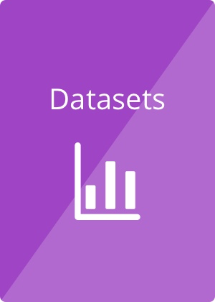
ABOUT DATASET
The dataset contained metadata for all 45000 movies listed on kaggle.
Link of dataset:
https://www.kaggle.com/rounakbanik/movie-recommender-systems/data
The dataset consists of movies released on or before July 2017.
Dataset available in the form of a stringified JSON Object.
This dataset contained features like cast, crew, plot keywords, budget, revenue, posters, release dates, languages, production companies, countries, TMDB vote counts, and vote averages.
Dataset Name | No. of feature | No. of Records
Credits | 3 | 45476
Movies_metadata | 24 | 45466
Keywords | 2 | 46419
Rating_small | 4 | 100004
Links | 3 | 45843
Links_small | 3 | 9125

Slide 13

TO BUILD THE RECOMMENDER SYSTEM MODEL BASED ON CONTENT FILTERING, COLLABRATIVE FILTERING AND POPULARITY BASED FITLERING
OBJECTIVE

Slide 14
METHODLOGY
Research Paper breakdown and setting up the direction of project
Baseline model preparation , foundation for project
Final Testing, define MLOP’s Pipeline and application quality check
Tuning the model to be robust , basic application building
Final Presentation

Slide 15
Data Pre-Processing
Reading CSV files using pandas
Data integrity Check for missing values, duplicates values etc.
Merging of Data frame
Creation of new features and removal of redundant features.
Recommendation system vise feature selection
P
R
o
J
Ec
t F
L
ow
Text Mining & Visualization
Lemmatization and stop words removals
Data cleaning with regular expression
Text vectorization using TFIDF or Word-2-Vec embedding
Word Cloud( e.g. genres, top 50 words etc.)
Plotting Visualization related corpus length parameter
Visualization related to numerical parameter (like rating, revenue, budget)
Base line Recommendation System:
Base on Popularity Index recommendation system
Content based recommender system using cosine similarity
Collaborative base recommender system
Fine tuning the model implementing MLOPs
Web application development using Stream lit
Final application and Quality Check
Deployment on Heroku
Model Building and Deployment

Slide 16
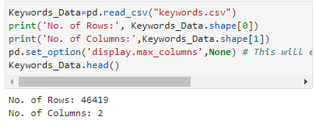
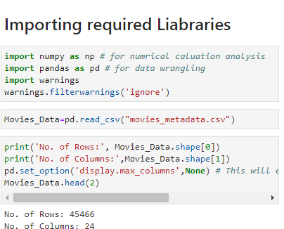
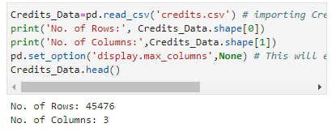
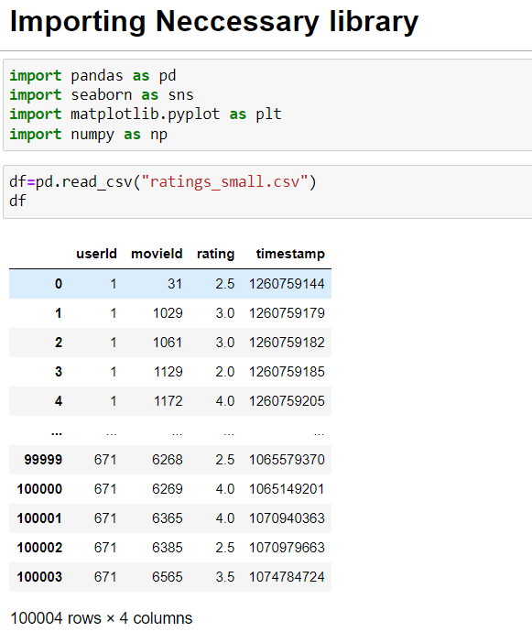
DATA PREPROCESSING: DATA MINING

Slide 17
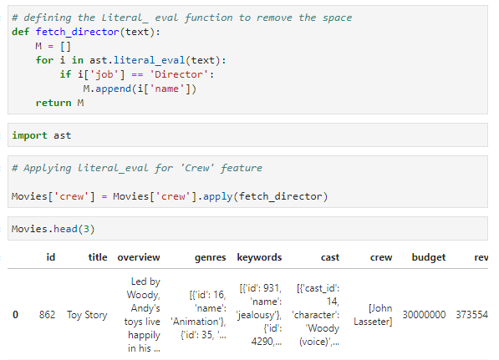
Literal_eval:
Literal_eval method is one of the helper functions that helps traverse an abstract syntax tree. This function evaluates an expression node or a string consisting of a Python literal or container display.
Abstract Syntax Tree(ast):
The ast module helps Python applications to process trees of the Python abstract syntax grammar. The abstract syntax itself might change with each Python release; this module helps to find out programmatically what the current grammar looks like.
Using ast and literal_eval function I have extracted the data from string dictionary

Slide 18
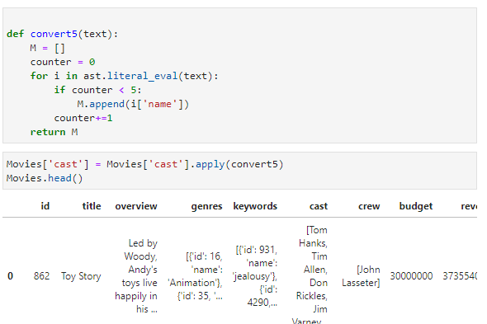
DATA PREPROCESSING: DATA MINING
I have converted the string dictionary data-frame into a list using def fuction

Slide 19
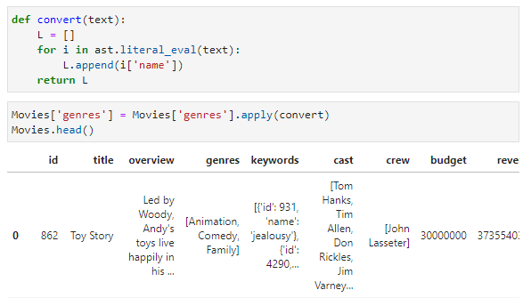
DATA PREPROCESSING: DATA MINING

Slide 20
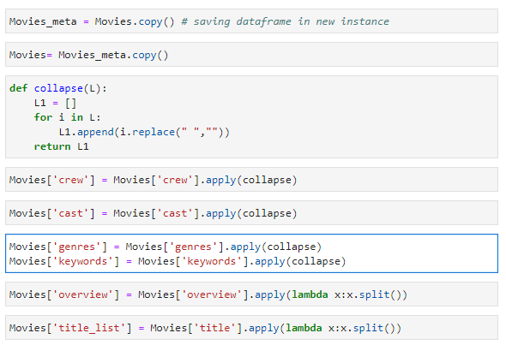
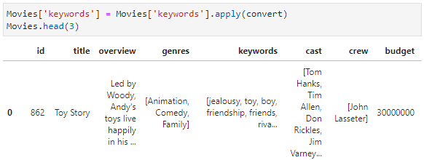
DATA PREPROCESSING: DATA MINING

Slide 21
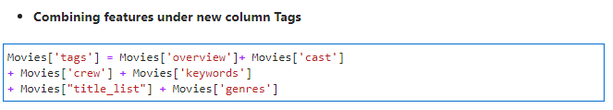
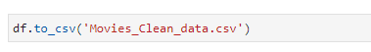
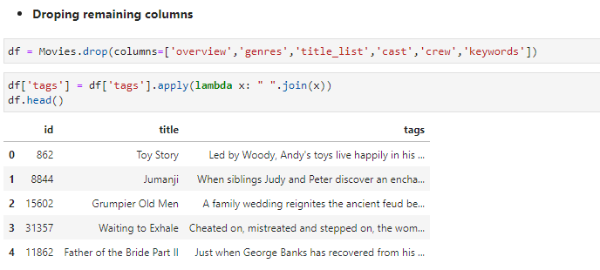
DATA PREPROCESSING: DATA MINING
Saving the clean data into csv file

Slide 22
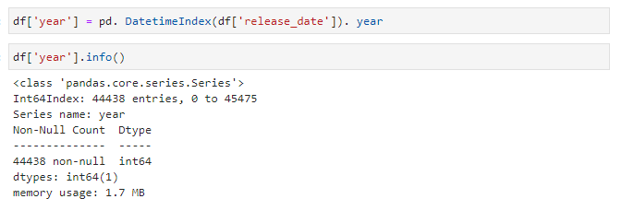
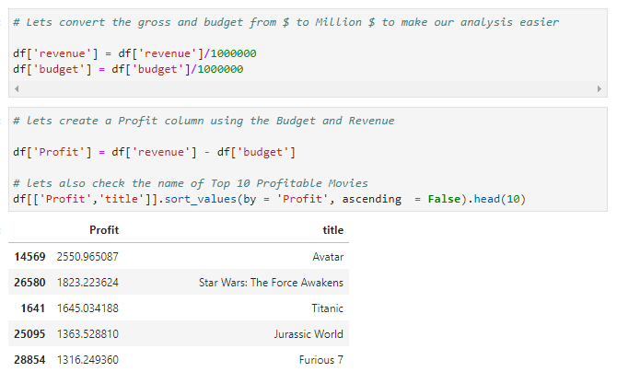
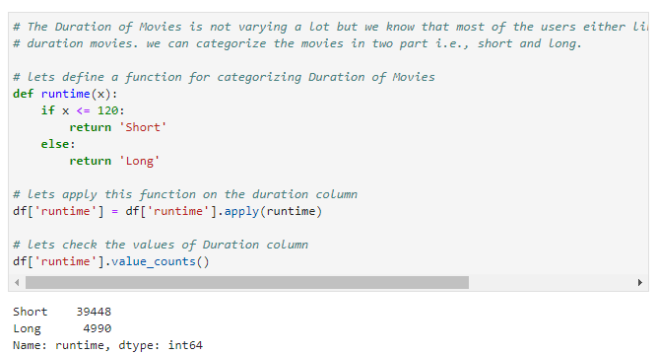
FEATURE ENGINEERING

Slide 23
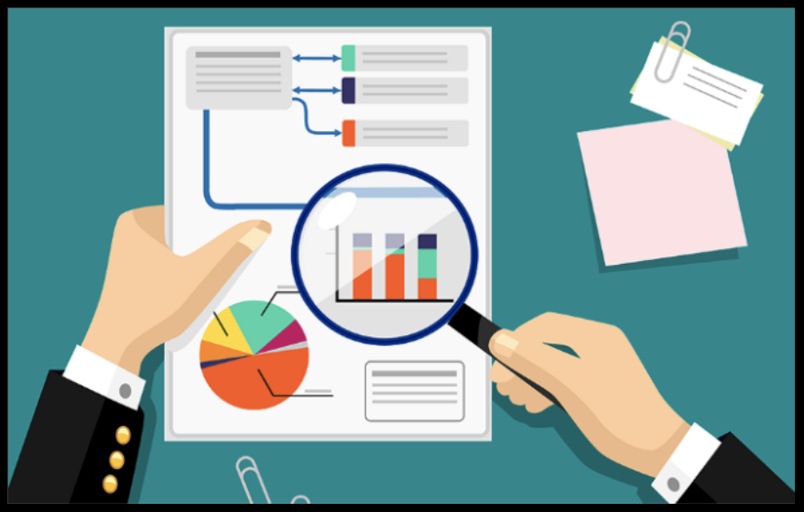
EXPLORATORY DATA ANALYSIS

Slide 24
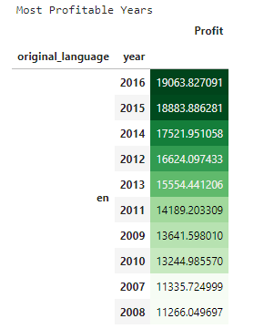
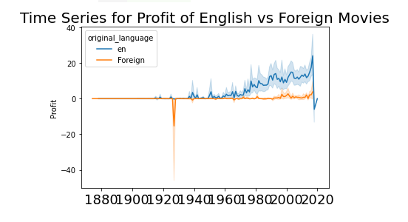
DATA VISUALIZATION
Graphs shows that year 2000-2020 profit margin is high of English movie than other language or foreign movies

Slide 25
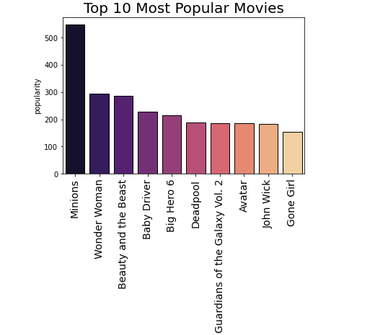
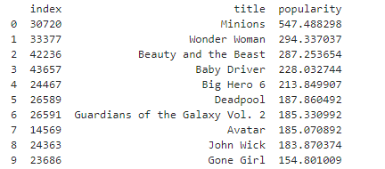
DATA VISUALIZATION
Insights
1. "Minions" is most popular movie followed by wonder woman.
2. "Gone Giri" is less popular movie.

Slide 26
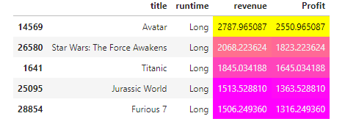
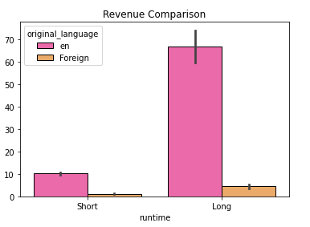
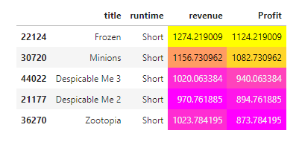
DATA VISUALIZATION
Insights:
Long duration movies have more profit than short duration movies

Slide 27
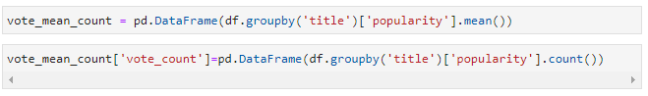
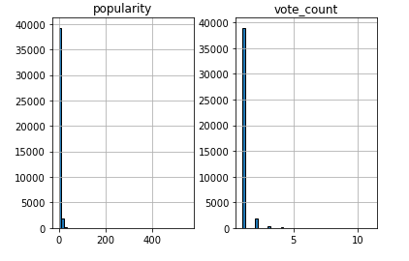
DATA VISUALIZATION
Insights :
popularity count varies between 0-50 approximately
Vote count falls from 0 – 5.

Slide 28
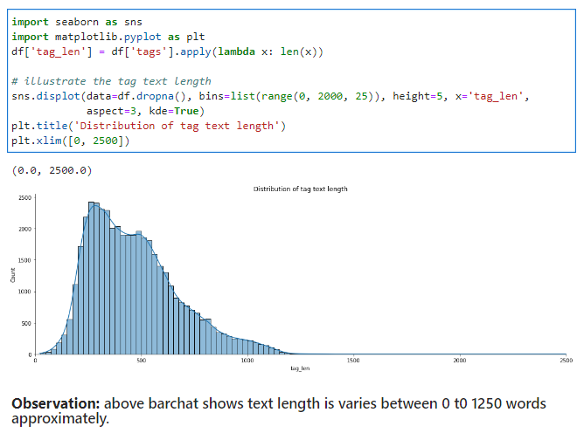
DATA VISUALIZATION
Insights:
This graphs shows the text length which varies between 0 to 1250 words approximately.

Slide 29
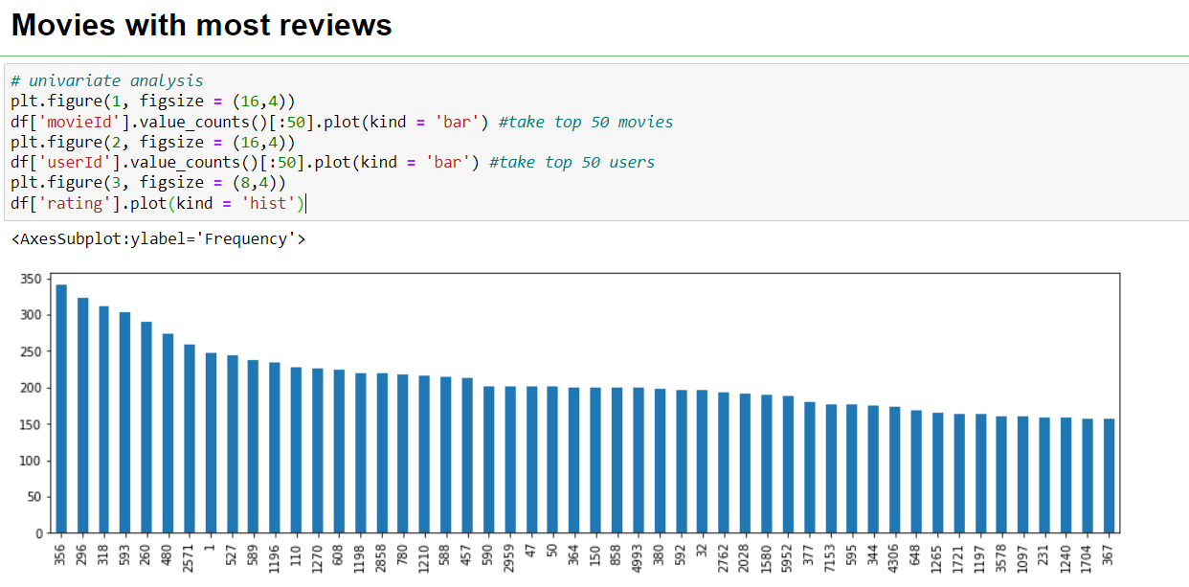
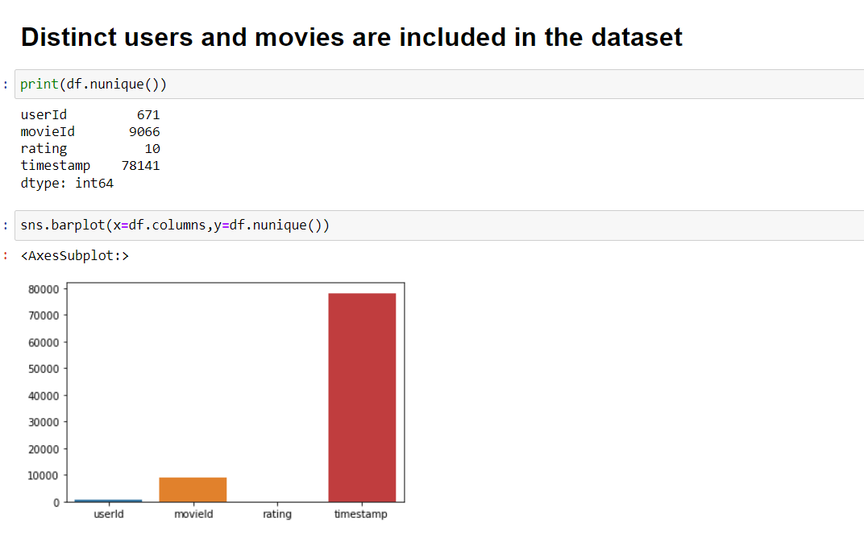
DATA VISUALIZATION

Slide 30
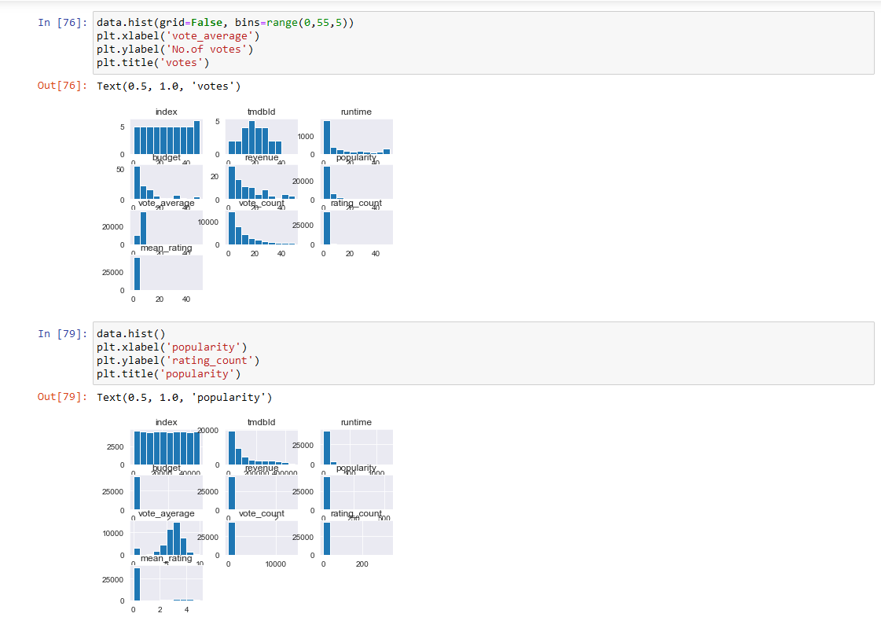
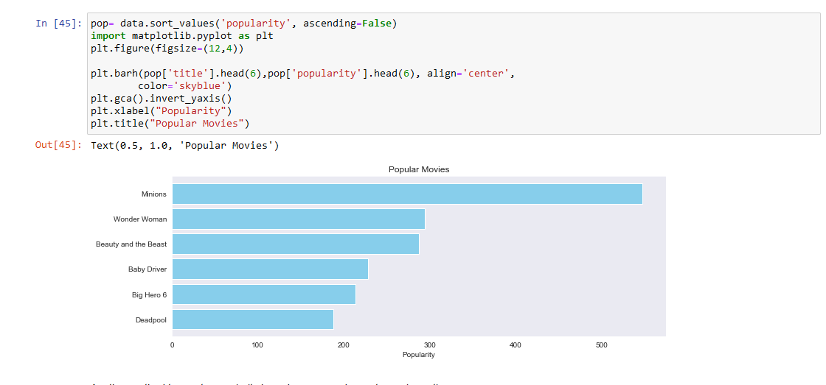
RELATION BETWEEN POPULARITY AND OTHER Features
ABOUT POPULARITY BASED RECOMMENDED SYSTEM:
Here we used 90th percentile as our cutoff. In other words, for a movie to feature in the charts, it must have more votes than at least 90% of the movies in the list.

Slide 31
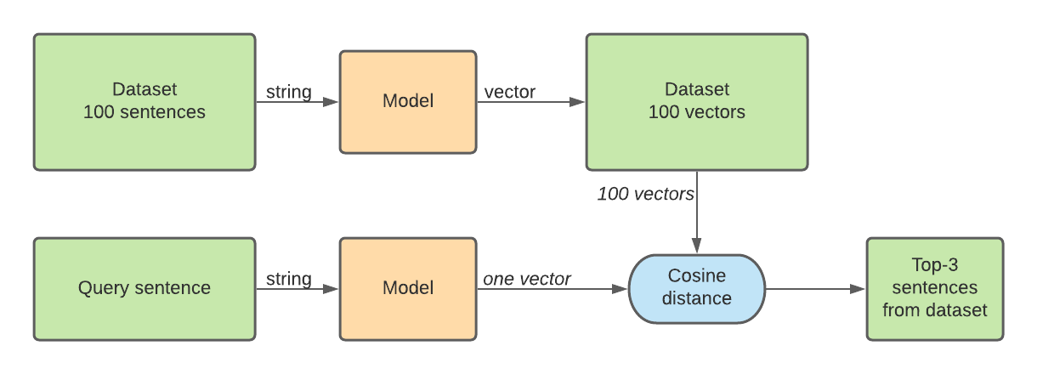
MODEL BUIDLING FOR CONTENT BASED RECOMENDER SYSTEM

Slide 32
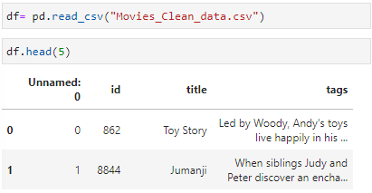
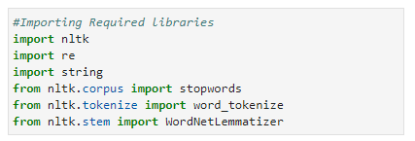
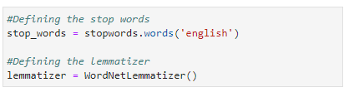
Text Mining using NLTK
Stop Words:
Stop words are the words in a stop list (or stoplist or negative dictionary) which are filtered out (i.e. Stopped) before or after processing of natural language data (text) because they are insignificant.
Lemmatization:
Lemmatization is the grouping together of different forms of the same word. In search queries, lemmatization allows end users to query any version of a base word and get relevant results.

Slide 33
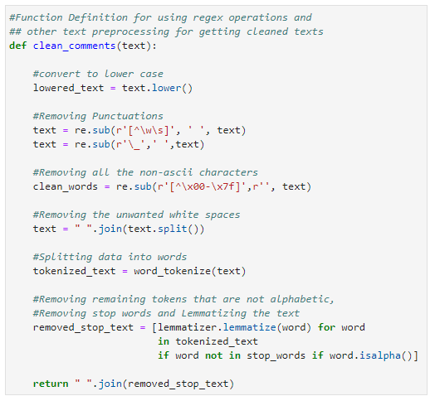
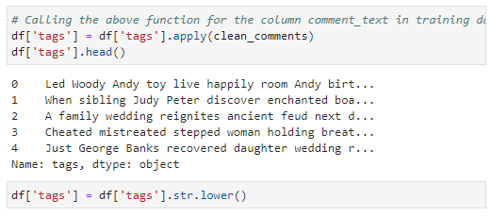

Slide 34
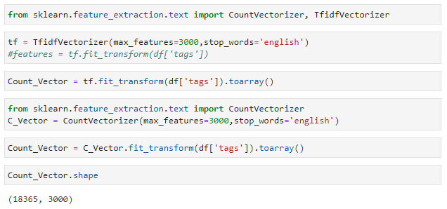
Count Vectorizer:
Count Vectorizer is a great tool provided by the scikit-learn library in Python. It is used to transform a given text into a vector on the basis of the frequency (count) of each word that occurs in the entire text. This is helpful when we have multiple such texts, and we wish to convert each word in each text into vectors.
TFIDF Vectorizer:
Term frequency — Inverse document frequency (TFIDF) is based on the Bag of Words (BoW) model, which contains insights about the less relevant and more relevant words in a document. The importance of a word in the text is of great significance in information retrieval.

Slide 35
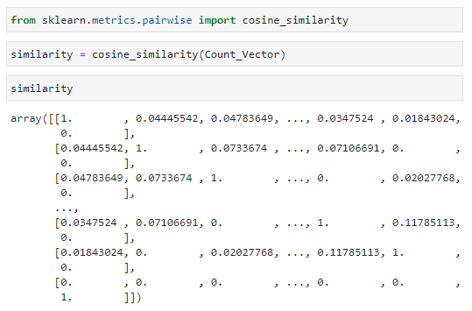
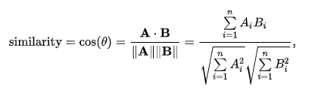
MODEL BUILDING USING COSINE SIMILARITY
Cosine Similarity:
Cosine similarity measures the similarity between two vectors of an inner product space. It is measured by the cosine of the angle between two vectors and determines whether two vectors are pointing in roughly the same direction. It is often used to measure document similarity in text analysis.
The cosine similarity is described mathematically as the division between the dot product of vectors and the product of the Euclidean norms or magnitude of each vector.

Slide 36
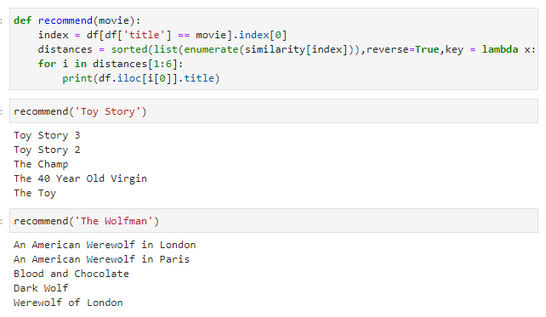
RECOMMENDATION

Slide 37
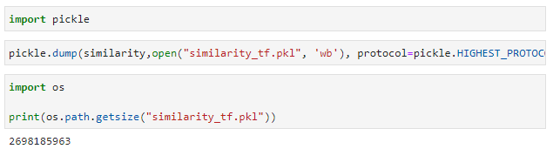

SAVING THE RECOMMENDATION

Slide 38



MODEL BUILDING USING WEIGHTED AVERAGE FOR POPULARITY BASED MODEL
Weighted Average formula

Slide 39

RECOMENDATION

Slide 40


MODEL BUILDING USING KNN AND SVD ALGORITHM FOR COLLABORATIVE RECOMMENDER SYSTEM

Slide 41


RECOMMENDATION

Slide 42


HYBRID RECOMENDER SYSTEM MODEL BUILDING

Slide 43

APPLICATION DEPLOYMENT
We build the web pages using the stream lit for our four types of recommender system.
Created the requirement.txt file for dependency
Setup.sh file created for stream lit
proc file created which required for cloud deployment.
Due to heavy size of pickle file we was unable to deploy it on cloud.
Please have look of our web pages.

Slide 44
REFERENCES
For Recommender System
https://en.wikipedia.org/wiki/Recommender_system
https://en.wikipedia.org/wiki/Recommender_system#Content-based_filtering
For literal Eval
https://www.educative.io/answers/what-is-astliteralevalnodeorstring-in-python
https://www.aipython.in/python-literal_eval/
For AST
https://docs.python.org/3/library/ast.html#:~:text=The%20ast%20module%20helps%20Python,be%20generated%20by%20passing%20ast.
https://medium.com/@wshanshan/intro-to-python-ast-module-bbd22cd505f7

Slide 45
REFERENCES
For Stop-words
https://www.geeksforgeeks.org/removing-stop-words-nltk-python/
For Lemmatization:
https://en.wikipedia.org/wiki/Lemmatisation
For TF-IDF:
https://en.wikipedia.org/wiki/Tf%E2%80%93idf
https://towardsdatascience.com/?source=post_page-----796d339a4089-------------------------------
Cosine Similarity:
https://en.wikipedia.org/wiki/Cosine_similarity
https://www.sciencedirect.com/topics/computer-science/cosine-similarity

Slide 46


CREDITS
Special thanks to Innomatics Research Lab and my teammates without their help and motivation this task will be incomplete.

Slide 47
THANKS!
Any questions?
You can find me at
byashshree2021@gmail.com or https://in.linkedin.com/in/yashshreeb91

